Slide 1

Exploratory Data Analysis:
Indian Premier League
2007-2024 Project
EDA by divyansh patel

Slide 2
Objectives of the Project :
Analyze Player Performance: Evaluate the performance of individual players, including batting and bowling statistics, strike rates, and consistency over different seasons.
Examine Team Performance: Assess the overall performance of different teams, their win/loss ratios, and key factors contributing to their success or failure.
Study Venue Statistics: Investigate the impact of various venues on match outcomes, home ground advantages, and venue-specific performance trends.
Identify Patterns and Trends: Detect patterns and trends in the data, such as the influence of toss decisions, high-scoring matches, and close finishes.
Provide Insights and Recommendations: Offer actionable insights and recommendations based on the data analysis to help teams, players, and stakeholders make informed decisions.

Slide 3
Introduction
The Indian Premier League (IPL) is a professional Twenty20 cricket league in India, established by the Board of Control for Cricket in India (BCCI) in 2007.
The league has rapidly become the most popular and financially rewarding cricket league globally, featuring top cricketing talent from around the world.
The IPL is known for its high-energy matches, star-studded teams, and vibrant fan base.

Slide 4
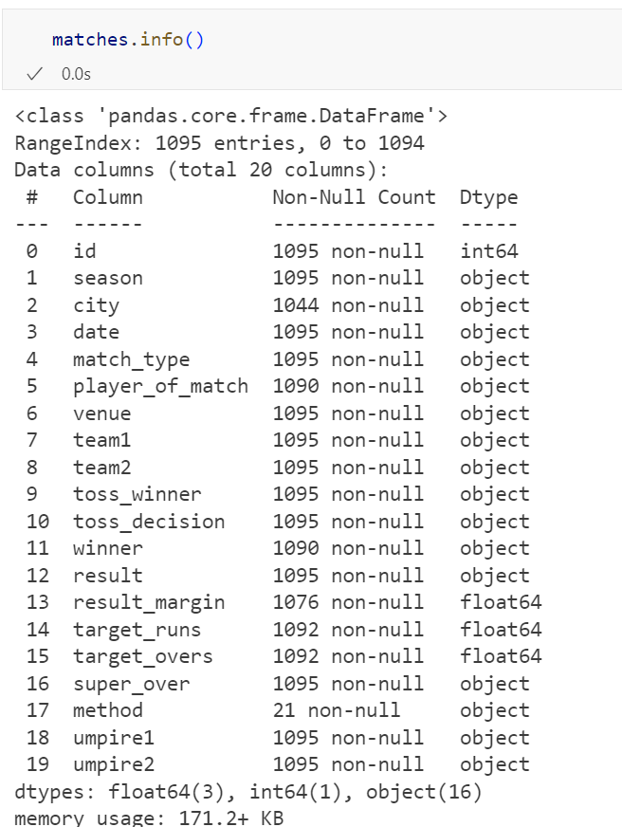
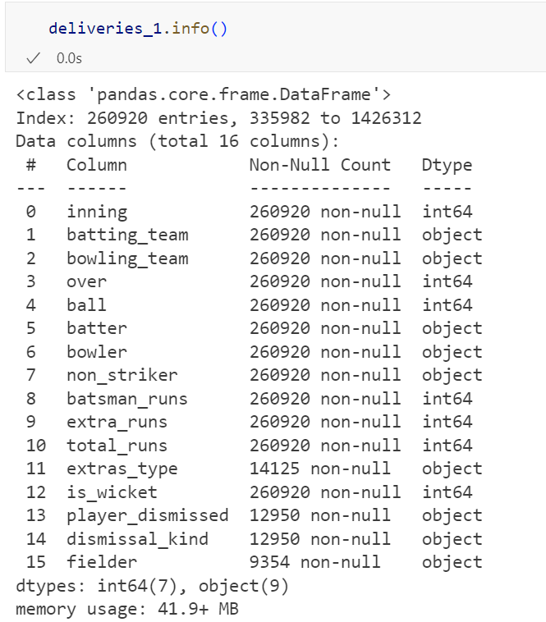
DATA SET OVERVIEW

Slide 5
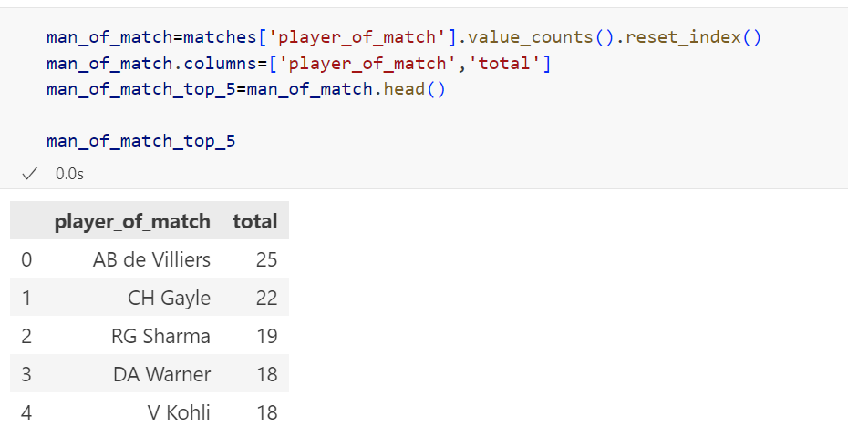
Q1 TOP 5 PLAYER RECEIVED MOST MAN OF THE MATCH AWARDS

Slide 6
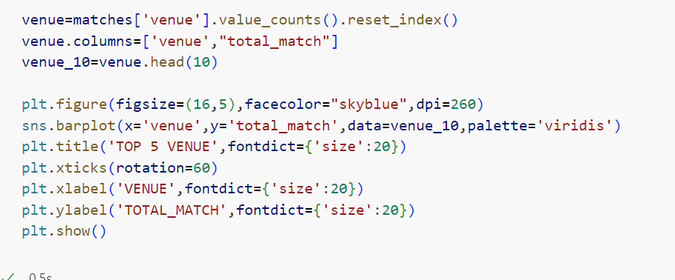
Q2 Top 10 venue

Slide 7
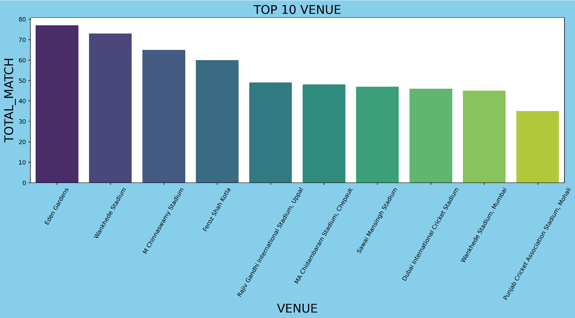

Slide 8

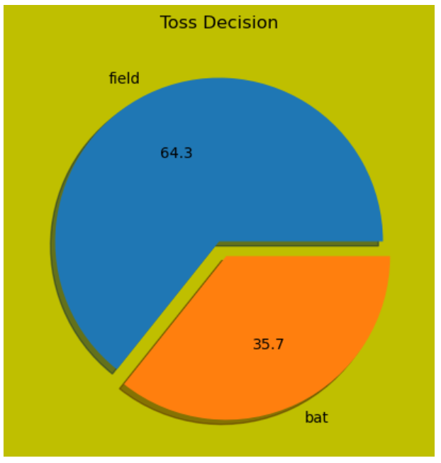
Q3 Toss decision in matches

Slide 9
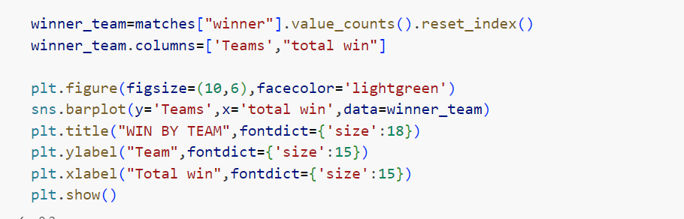
Q4 Matches win by each team in Ipl

Slide 10
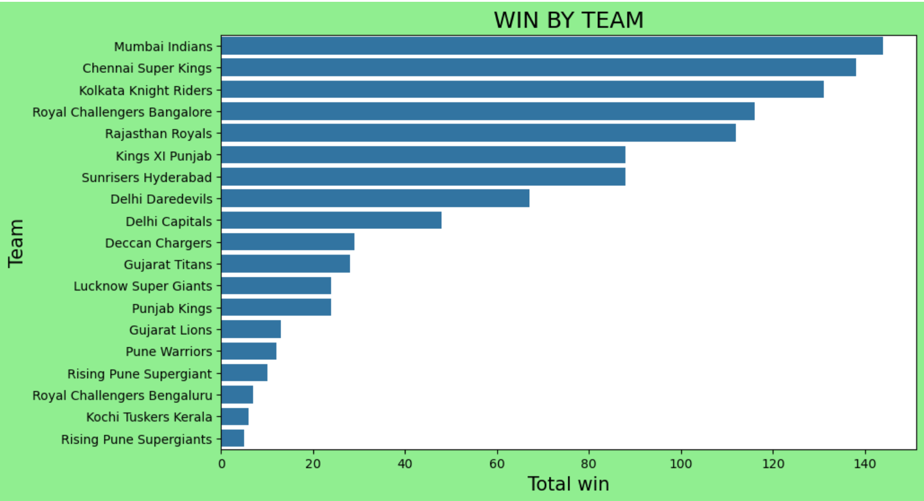

Slide 11
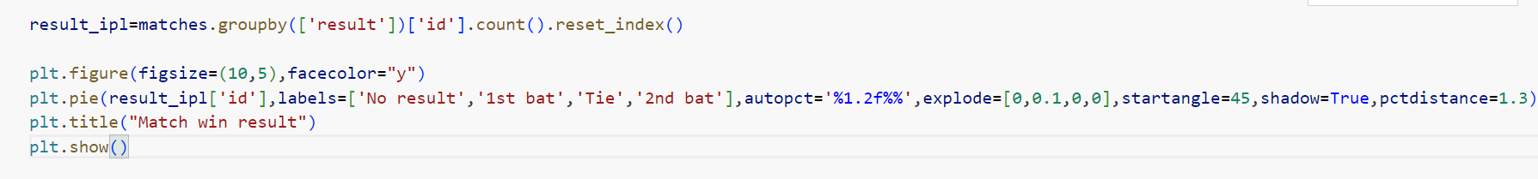
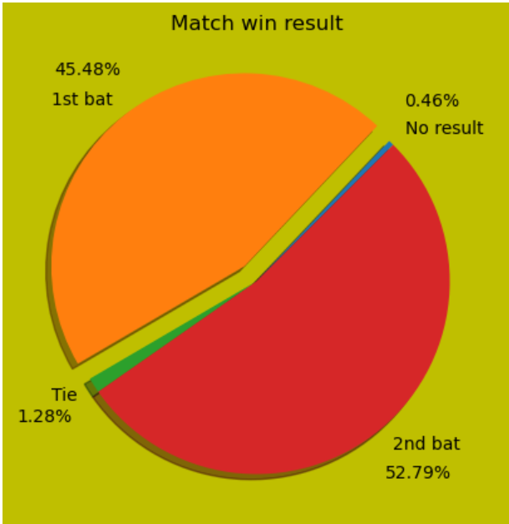
Q5 matches win by result

Slide 12
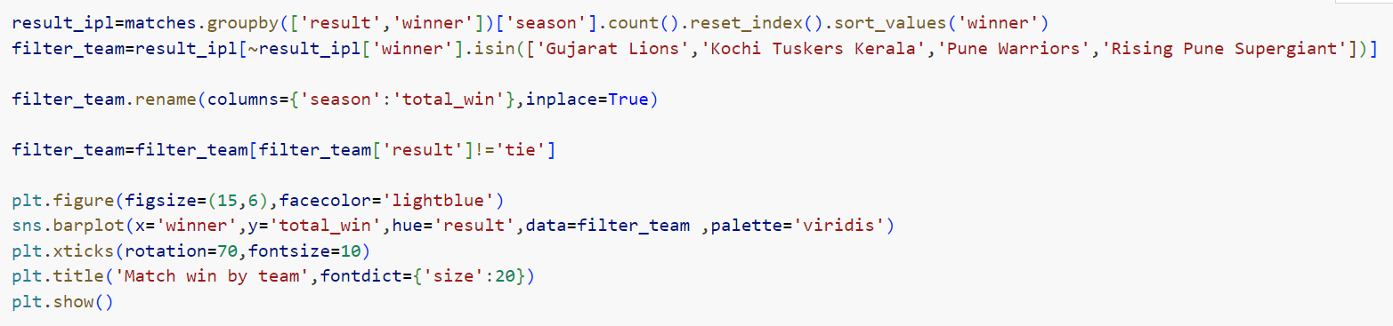
Q6 Match win by team

Slide 13
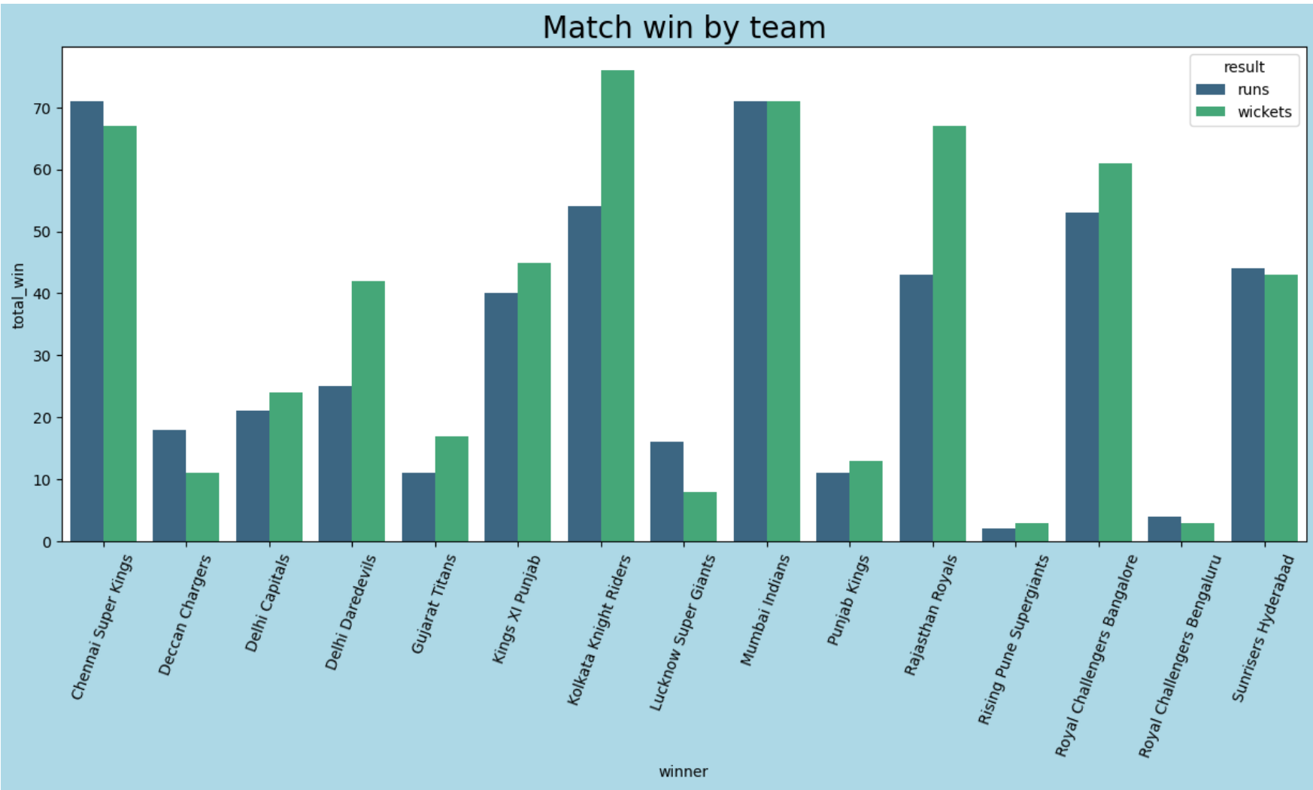

Slide 14
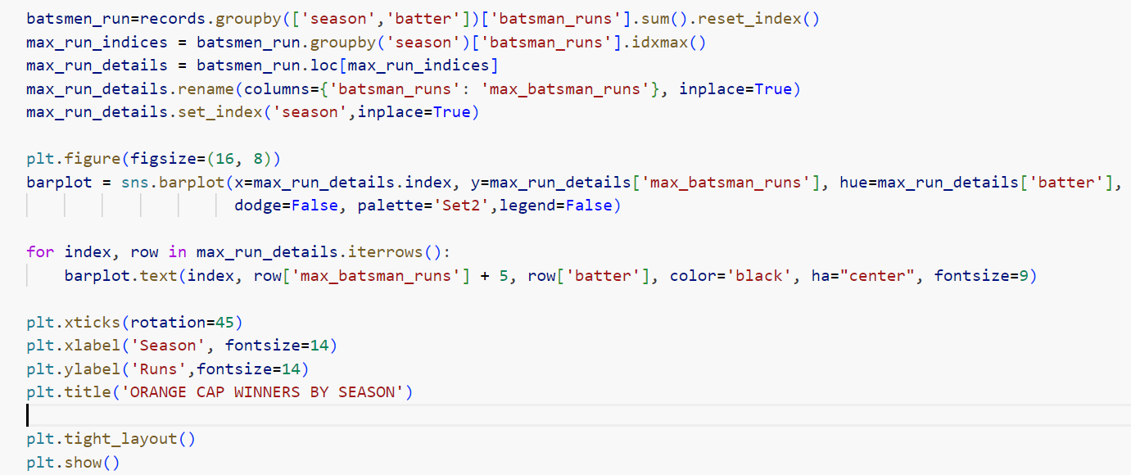
Q7 orange cap holder

Slide 15
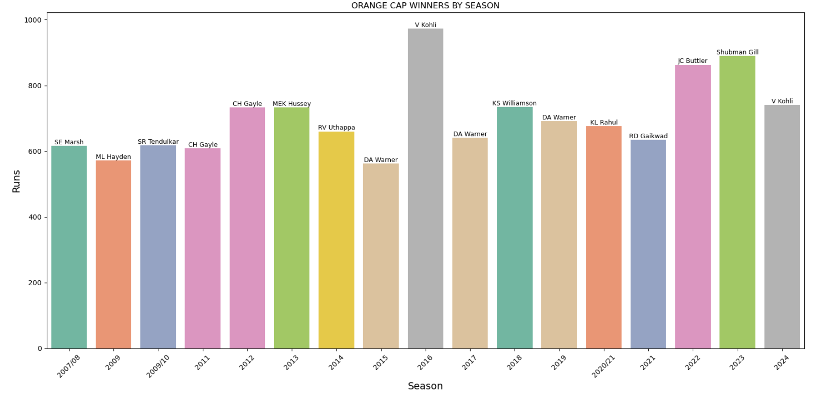

Slide 16

Q9 Purple Cap Winners by Season

Slide 17
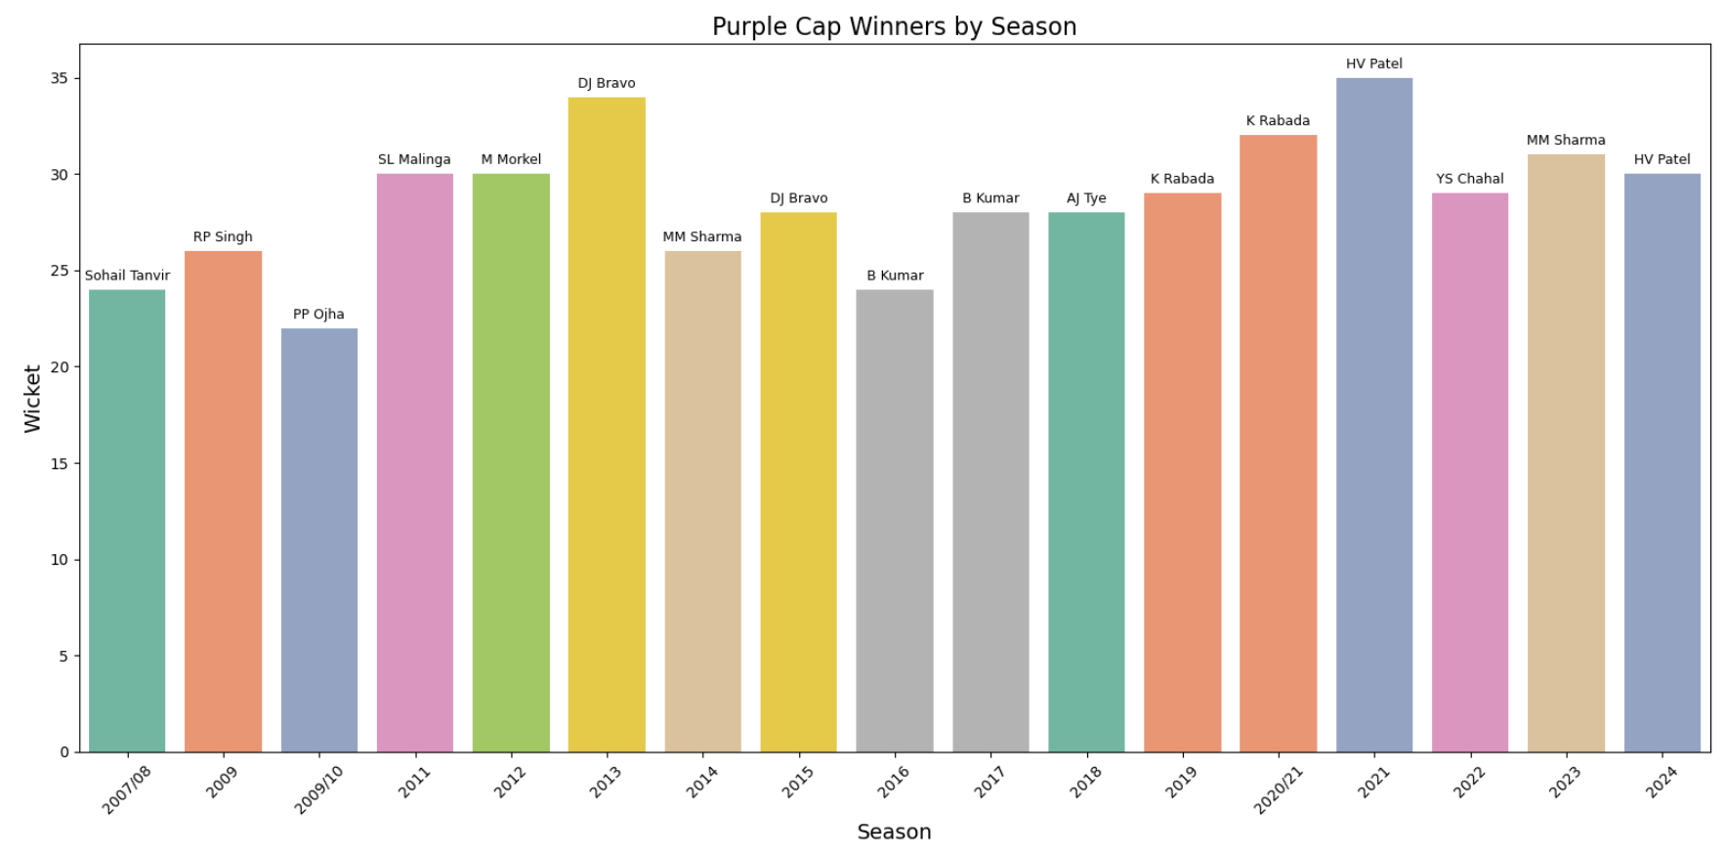

Slide 18
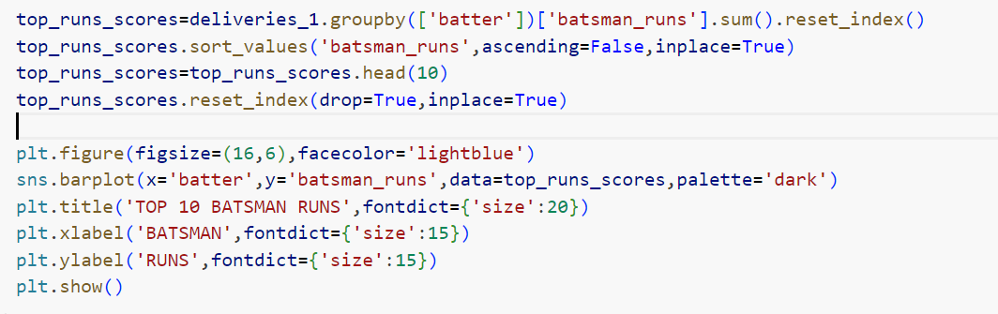
Q10 Top 10 runs scorers

Slide 19
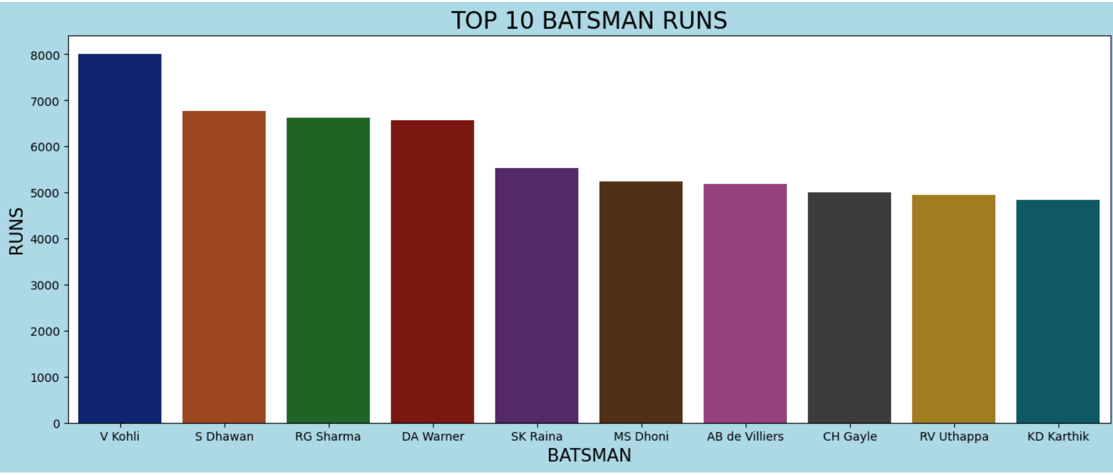

Slide 20
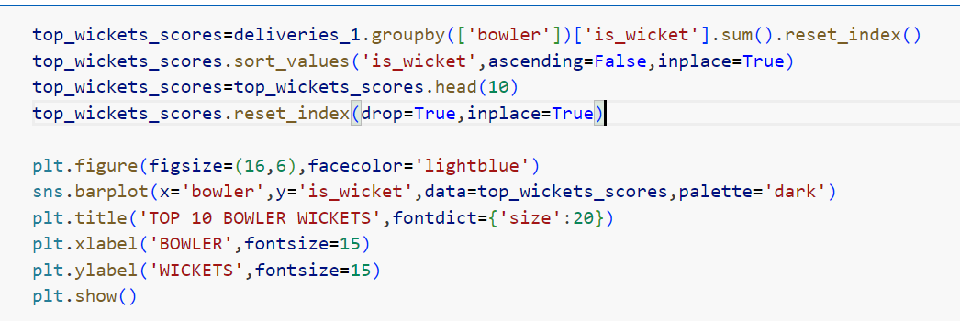
Q12 TOP 10 BOWLER WICKETS

Slide 21
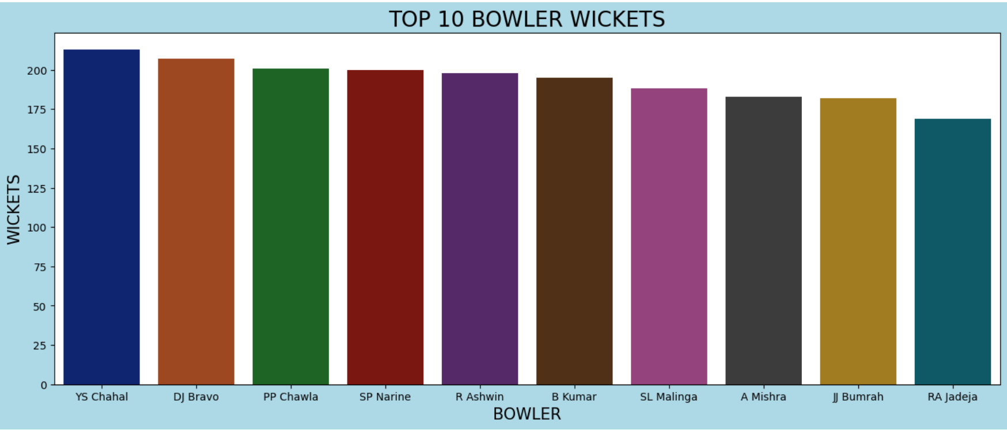

Slide 22
Conclusion
Player Performance: Identified top-performing batsmen and bowlers, their averages, strike rates, and consistency across different seasons. Key players like Virat Kohli and Lasith Malinga consistently showed exceptional performances.
Team Performance: Analyzed team statistics, revealing that Mumbai Indians and Chennai Super Kings have been the most successful teams, with high win ratios and multiple championships.
Venue Statistics: Examined venue-specific data, showing that certain venues like Eden Gardens and Wankhede Stadium have a significant home-ground advantage.
Match Patterns: Discovered trends such as the impact of toss decisions on match outcomes and the prevalence of high-scoring matches at specific venues.
Close Finishes: Noted several closely contested matches, emphasizing the unpredictable and thrilling nature of IPL games

